Slide 1

Finding Love in Literary Studies
Benjamin D. Hagen, Ph.D.
Fall 2021 Colloquium Series

Slide 2
For a useful handout, go to bdavidhagen.com

Slide 3
Outline
Dedication
Epigraph
Love’s Conceptual Function
Love’s Slidey-ness
Love Problems

Slide 4
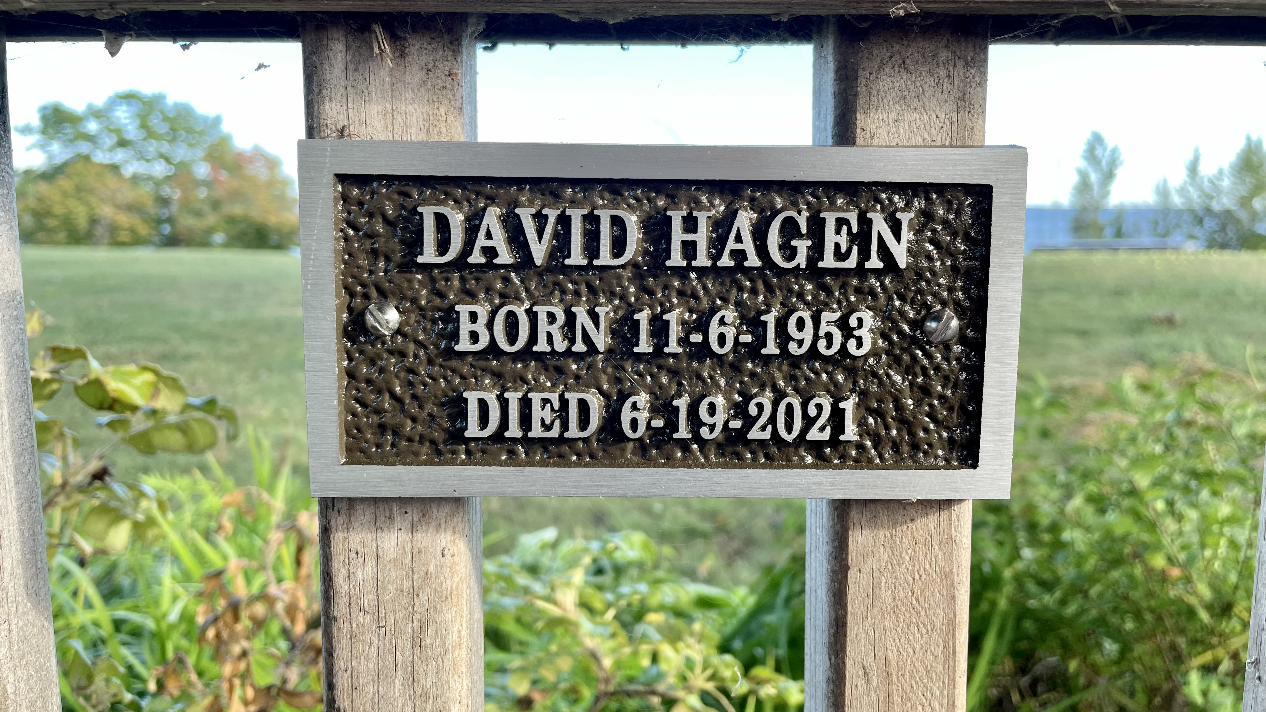
Dedication

Slide 5
Epigraph
I think that for many of us in childhood the ability to attach intently to a few cultural objects, objects of high or popular culture or both, objects whose meaning seemed mysterious, excessive, or oblique in relation to the codes most readily available to us, became a prime resource for survival. We needed for there to be sites where the meanings didn’t line up tidily with each other, and we learned to invest those sites with fascination and love. This can’t help coloring the adult relation to cultural texts and objects; in fact, it’s almost hard for me to imagine another way of coming to care enough about literature to give a lifetime to it.
– Eve Kosofsky Sedgwick, Tendencies (1993), p. 3

Slide 6

Part 1: Love’s Conceptual Function

Slide 7
Derek Walcott:
Love after Love (1976)
The time will come
when, with elation,
you will greet yourself arriving
at your own door, in your own mirror,
and each will smile at the other’s welcome,
and say, sit here. Eat.
You will love again the stranger who was your self.
Give wine. Give bread. Give back your heart
to itself, to the stranger who has loved you
all your life, whom you ignored
for another, who knows you by heart.
Take down the love-letters from the bookshelf,
the photographs, the desperate notes,
peel your own image from the mirror.
Sit. Feast on your life. (Walcott 328)

Slide 8
Derek Walcott:
Love after Love (1976)
The time will come
when, with elation,
you will greet yourself arriving
at your own door, in your own mirror,
and each will smile at the other’s welcome,
and say, sit here. Eat.
You will love again the stranger who was your self.
Give wine. Give bread. Give back your heart
to itself, to the stranger who has loved you
all your life, whom you ignored
for another, who knows you by heart.
Take down the love-letters from the bookshelf,
the photographs, the desperate notes,
peel your own image from the mirror.
Sit. Feast on your life. (Walcott 328)

Slide 9
Derek Walcott:
Love after Love (1976)
The time will come
when, with elation,
you will greet yourself arriving
at your own door, in your own mirror,
and each will smile at the other’s welcome,
and say, sit here. Eat.
You will love again the stranger who was your self.
Give wine. Give bread. Give back your heart
to itself, to the stranger who has loved you
all your life, whom you ignored
for another, who knows you by heart.
Take down the love-letters from the bookshelf,
the photographs, the desperate notes,
peel your own image from the mirror.
Sit. Feast on your life. (Walcott 328)

Slide 10
Derek Walcott:
Love after Love (1976)
The time will come
when, with elation,
you will greet yourself arriving
at your own door, in your own mirror,
and each will smile at the other’s welcome,
and say, sit here. Eat.
You will love again the stranger who was your self.
Give wine. Give bread. Give back your heart
to itself, to the stranger who has loved you
all your life, whom you ignored
for another, who knows you by heart.
Take down the love-letters from the bookshelf,
the photographs, the desperate notes,
peel your own image from the mirror.
Sit. Feast on your life. (Walcott 328)

Slide 11
Derek Walcott:
Love after Love (1976)
The time will come
when, with elation,
you will greet yourself arriving
at your own door, in your own mirror,
and each will smile at the other’s welcome,
and say, sit here. Eat.
You will love again the stranger who was your self.
Give wine. Give bread. Give back your heart
to itself, to the stranger who has loved you
all your life, whom you ignored
for another, who knows you by heart.
Take down the love-letters from the bookshelf,
the photographs, the desperate notes,
peel your own image from the mirror.
Sit. Feast on your life. (Walcott 328)

Slide 12
Derek Walcott:
Love after Love (1976)
The time will come
when, with elation,
you will greet yourself arriving
at your own door, in your own mirror,
and each will smile at the other’s welcome,
and say, sit here. Eat.
You will love again the stranger who was your self.
Give wine. Give bread. Give back your heart
to itself, to the stranger who has loved you
all your life, whom you ignored
for another, who knows you by heart.
Take down the love-letters from the bookshelf,
the photographs, the desperate notes,
peel your own image from the mirror.
Sit. Feast on your life. (Walcott 328)

Slide 13
Derek Walcott:
Love after Love (1976)
The time will come
when, with elation,
you will greet yourself arriving
at your own door, in your own mirror,
and each will smile at the other’s welcome,
and say, sit here. Eat.
You will love again the stranger who was your self.
Give wine. Give bread. Give back your heart
to itself, to the stranger who has loved you
all your life, whom you ignored
for another, who knows you by heart.
Take down the love-letters from the bookshelf,
the photographs, the desperate notes,
peel your own image from the mirror.
Sit. Feast on your life. (Walcott 328)

Slide 14
Derek Walcott:
Love after Love (1976)
The time will come
when, with elation,
you will greet yourself arriving
at your own door, in your own mirror,
and each will smile at the other’s welcome,
and say, sit here. Eat.
You will love again the stranger who was your self.
Give wine. Give bread. Give back your heart
to itself, to the stranger who has loved you
all your life, whom you ignored
for another, who knows you by heart.
Take down the love-letters from the bookshelf,
the photographs, the desperate notes,
peel your own image from the mirror.
Sit. Feast on your life. (Walcott 328)

Slide 15
Derek Walcott:
Love after Love (1976)
The time will come
when, with elation,
you will greet yourself arriving
at your own door, in your own mirror,
and each will smile at the other’s welcome,
and say, sit here. Eat.
You will love again the stranger who was your self.
Give wine. Give bread. Give back your heart
to itself, to the stranger who has loved you
all your life, whom you ignored
for another, who knows you by heart.
Take down the love-letters from the bookshelf,
the photographs, the desperate notes,
peel your own image from the mirror.
Sit. Feast on your life. (Walcott 328)

Slide 16
Derek Walcott:
Love after Love (1976)
The time will come
when, with elation,
you will greet yourself arriving
at your own door, in your own mirror,
and each will smile at the other’s welcome,
and say, sit here. Eat.
You will love again the stranger who was your self.
Give wine. Give bread. Give back your heart
to itself, to the stranger who has loved you
all your life, whom you ignored
for another, who knows you by heart.
Take down the love-letters from the bookshelf,
the photographs, the desperate notes,
peel your own image from the mirror.
Sit. Feast on your life. (Walcott 328)

Slide 17
Derek Walcott:
Love after Love (1976)
The time will come
when, with elation,
you will greet yourself arriving
at your own door, in your own mirror,
and each will smile at the other’s welcome,
and say, sit here. Eat.
You will love again the stranger who was your self.
Give wine. Give bread. Give back your heart
to itself, to the stranger who has loved you
all your life, whom you ignored
for another, who knows you by heart.
Take down the love-letters from the bookshelf,
the photographs, the desperate notes,
peel your own image from the mirror.
Sit. Feast on your life. (Walcott 328)

Slide 18
Derek Walcott:
Love after Love (1976)
The time will come
when, with elation,
you will greet yourself arriving
at your own door, in your own mirror,
and each will smile at the other’s welcome,
and say, sit here. Eat.
You will love again the stranger who was your self.
Give wine. Give bread. Give back your heart
to itself, to the stranger who has loved you
all your life, whom you ignored
for another, who knows you by heart.
Take down the love-letters from the bookshelf,
the photographs, the desperate notes,
peel your own image from the mirror.
Sit. Feast on your life. (Walcott 328)

Slide 19
Derek Walcott:
Love after Love (1976)
The time will come
when, with elation,
you will greet yourself arriving
at your own door, in your own mirror,
and each will smile at the other’s welcome,
and say, sit here. Eat.
You will love again the stranger who was your self.
Give wine. Give bread. Give back your heart
to itself, to the stranger who has loved you
all your life, whom you ignored
for another, who knows you by heart.
Take down the love-letters from the bookshelf,
the photographs, the desperate notes,
peel your own image from the mirror.
Sit. Feast on your life. (Walcott 328)

Slide 20
Derek Walcott:
Love after Love (1976)
The time will come
when, with elation,
you will greet yourself arriving
at your own door, in your own mirror,
and each will smile at the other’s welcome,
and say, sit here. Eat.
You will love again the stranger who was your self.
Give wine. Give bread. Give back your heart
to itself, to the stranger who has loved you
all your life, whom you ignored
for another, who knows you by heart.
Take down the love-letters from the bookshelf,
the photographs, the desperate notes,
peel your own image from the mirror.
Sit. Feast on your life. (Walcott 328)

Slide 21
Derek Walcott:
Love after Love (1976)
The time will come
when, with elation,
you will greet yourself arriving
at your own door, in your own mirror,
and each will smile at the other’s welcome,
and say, sit here. Eat.
You will love again the stranger who was your self.
Give wine. Give bread. Give back your heart
to itself, to the stranger who has loved you
all your life, whom you ignored
for another, who knows you by heart.
Take down the love-letters from the bookshelf,
the photographs, the desperate notes,
peel your own image from the mirror.
Sit. Feast on your life. (Walcott 328)

Slide 22
Derek Walcott:
Love after Love (1976)
The time will come
when, with elation,
you will greet yourself arriving
at your own door, in your own mirror,
and each will smile at the other’s welcome,
and say, sit here. Eat.
You will love again the stranger who was your self.
Give wine. Give bread. Give back your heart
to itself, to the stranger who has loved you
all your life, whom you ignored
for another, who knows you by heart.
Take down the love-letters from the bookshelf,
the photographs, the desperate notes,
peel your own image from the mirror.
Sit. Feast on your life. (Walcott 328)

Slide 23
Part 2: Love’s Slidey-ness

Slide 24


Dualisms: Idealist v. Realist | Social v. Biological

Slide 25
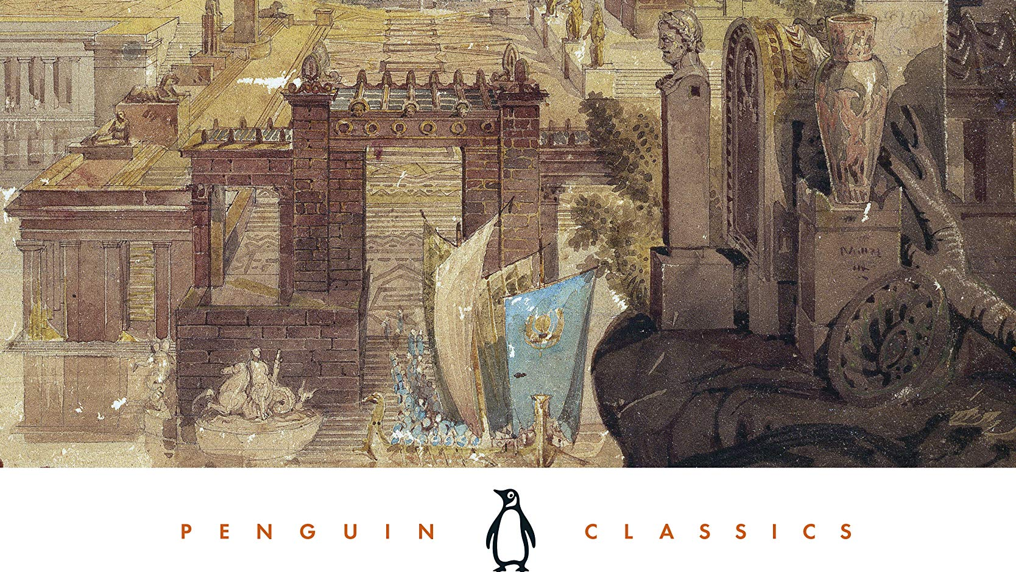
Literary v. Philosophical Study?

Slide 26
Part 2: Love’s Slidey-ness

Slide 27
D.H. Lawrence: The Rainbow (1915)
Passage 1a
Inside the room was a great stead-iness, a core of living eternity. Only far outside, at the rim, went on the noise and the distraction. Here at the centre the great wheel was motion-less, centred upon itself. Here was a poised, unflawed stillness that was beyond time, because it remained the same, inexhaustible, unchanging, unexhausted . . .

Slide 28
D.H. Lawrence: The Rainbow (1915)
Passage 1b
As they lay close together, complete and beyond the touch of time or change, it was as if they were at the very centre of all the slow wheeling of space and the rapid agitation of life, deep, deep inside them all, at the centre where there is utter radiance, and eternal being, and the silence absorbed in praise: the steady core of all movements, the unawakened sleep of all wakefulness. They found themselves there, and they lay still, in each other's arms; for their moment they were at the heart of eternity, whilst time roared far off, forever far off, towards the rim. (135)

Slide 29
D.H. Lawrence: The Rainbow (1915)
Passage 2a
. . . then, quite calmly, even a little surprised, she was in the present, and was saying: "I am dying with hunger."
"So am I," he said calmly, as if it were of not the slightest significance. And they relapsed into the warm, golden stillness. And the minutes flowed unheeded past the window outside.
Then suddenly she stirred against him.
"My dear, I am dying of hunger," she said.
It was a slight pain to him to be brought to.
"We'll get up," he said, unmoving.
And she sank her head on to him again, and they lay still, lapsing. Half consciously, he heard the clock chime the hour. She did not hear . . .

Slide 30
D.H. Lawrence: The Rainbow (1915)
"Do get up," she murmured at length, "and give me something to eat."
"Yes," he said, and he put his arms round her, and she lay with her face on him. They were faintly astonished that they did not move. The minutes rustled louder at the window.
"Let me go then," he said.
She lifted her head from him, relinquishingly. With a little breaking away, he moved out of bed, and was taking his clothes. She stretched out her hand to him.
"You are so nice," she said, and he went back for a moment or two. (135–36)

Slide 31
Part 2: Love’s Slidey-ness

Slide 32
For a useful handout, go to bdavidhagen.com

Slide 33
Part 3: Love Problems

Slide 34
Reading Cross-wise/Promiscuously
Modernist studies
Victorian studies
Early modern studies
Contemporary literature
Feminism
Psychoanalysis
Formalism
Black studies
Queer studies
Philosophy of emotion
Postcritique
Metaphysics
Political philosophy
Aesthetics
Poetics
Pauline theology
Autotheory
And more…

Slide 35
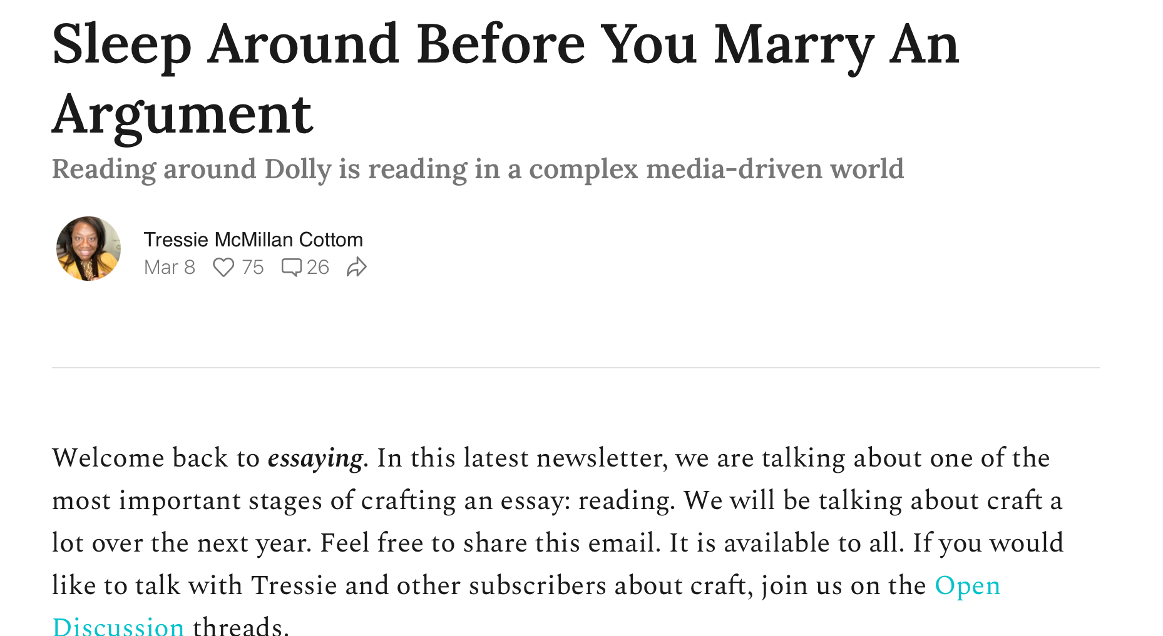

Slide 36

Melissa Sanchez

Slide 37
Love Problems
Love’s
Greatness
Love’s
Prepositions
Love’s
Genres
Love’s
Politics

Slide 38
Love Problems
Love’s
Greatness
Love’s
Prepositions
Love’s
Genres
Love’s
Politics

Slide 39
1 Corinthians 13:1–3 (NASB)
1 If I speak with the tongues of men and of angels, but do not have love, I have become a noisy gong or a clanging cymbal.
2 And if I have the gift of prophecy, and know all mysteries and all knowledge; and if I have all faith, so as to remove mountains, but do not have love, I am nothing.
3 And if I give all my possessions to feed the poor, and if I deliver my body to be burned, but do not have love, it profits me nothing.

Slide 40
Love Problems
Love’s
Greatness
Love’s
Prepositions
Love’s
Genres
Love’s
Politics

Slide 41


Michael Hardt and Antonio Negri

Slide 42

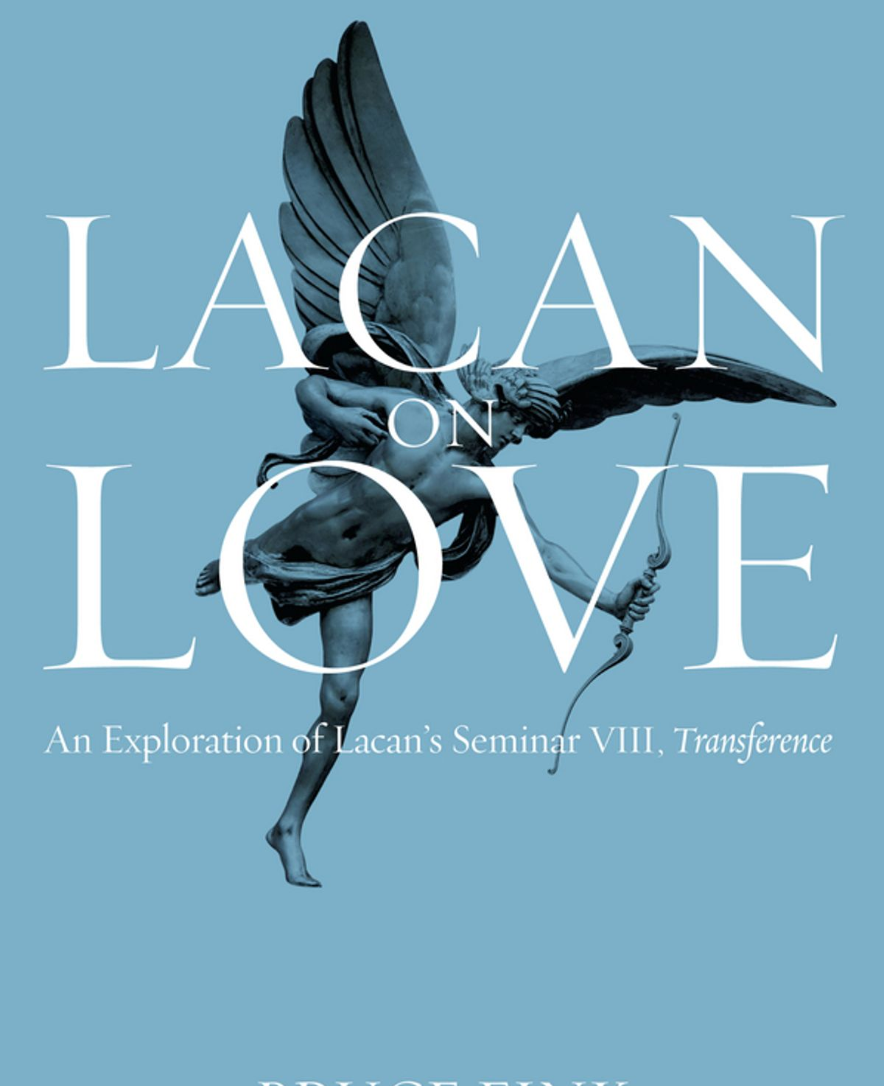

Psychoanalysis

Slide 43
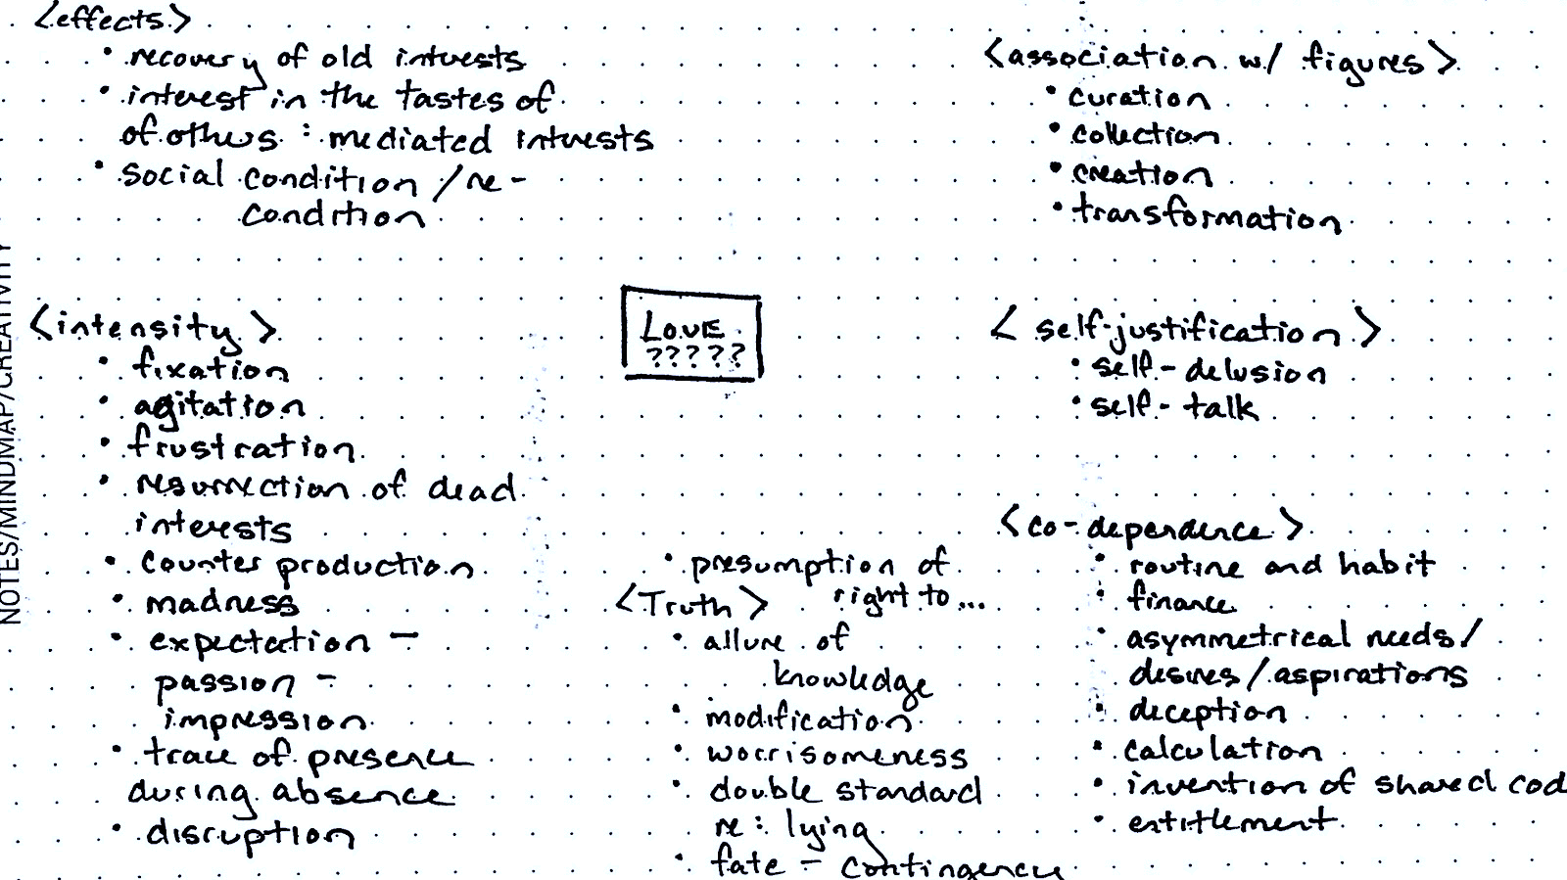
Marcel Proust’s Swann in Love (1913)

Slide 44
Love Problems
Love’s
Greatness
Love’s
Prepositions
Love’s
Genres
Love’s
Politics

Slide 45


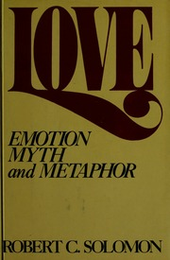
Robert Solomon – Loving With

Slide 46


Luce Irigaray – Loving To/At

Slide 47

Ashon Crawley – Loving To/In/With; On/Of/From; For/With/In; With/On/Along

Slide 48
Lucille Clifton, “daughters” (1993)
daughters
woman who shines at the head
of my grandmother's bed,
brilliant woman, i like to think
you whispered into her ear
instructions. i like to think
you are the oddness in us,
you are the arrow
that pierced our plain skin
and made us fancy women;
my wild witch gran, my magic mama,
and even these gaudy girls.
i like to think you gave us
extraordinary power and to
protect us, you became the name
we were cautioned to forget.
it is enough,
you must have murmured,
to remember that i was
and that you are. woman, i am
lucille, which stands for light,
daughter of thelma, daughter
of georgia, daughter of
dazzling you. (13)

Slide 49
Lucille Clifton, “daughters” (1993)
daughters
woman who shines at the head
of my grandmother's bed,
brilliant woman, i like to think
you whispered into her ear
instructions. i like to think
you are the oddness in us,
you are the arrow
that pierced our plain skin
and made us fancy women;
my wild witch gran, my magic mama,
and even these gaudy girls.
i like to think you gave us
extraordinary power and to
protect us, you became the name
we were cautioned to forget.
it is enough,
you must have murmured,
to remember that i was
and that you are. woman, i am
lucille, which stands for light,
daughter of thelma, daughter
of georgia, daughter of
dazzling you. (13)

Slide 50
Love Problems
Love’s
Greatness
Love’s
Prepositions
Love’s
Genres
Love’s
Politics

Slide 51

Martha Nussbaum

Slide 52
Love Problems
Love’s
Greatness
Love’s
Prepositions
Love’s
Genres
Love’s
Politics

Slide 53
Lucille Clifton, “daughters” (1993)
daughters
woman who shines at the head
of my grandmother's bed,
brilliant woman, i like to think
you whispered into her ear
instructions. i like to think
you are the oddness in us,
you are the arrow
that pierced our plain skin
and made us fancy women;
my wild witch gran, my magic mama,
and even these gaudy girls.
i like to think you gave us
extraordinary power and to
protect us, you became the name
we were cautioned to forget.
it is enough,
you must have murmured,
to remember that i was
and that you are. woman, i am
lucille, which stands for light,
daughter of thelma, daughter
of georgia, daughter of
dazzling you. (13)

Slide 54

James Kuzner

Slide 55
Love Problems
Love’s
Greatness
Love’s
Prepositions
Love’s
Genres
Love’s
Politics

Slide 56

Jacques Derrida

Slide 57
Derrida, The Politics of Friendship
Perhaps, one day, here or there, who knows, something may happen between two people in love, who would love each other lovingly (is this still the right word?) in such a way that friendship, just once, perhaps, for the first time (another perhaps), once and only once, therefore for the first and last time (perhaps, perhaps), will become the correct name, the right and just name for that which would then have taken place, the condition being that it take place between two . . . Even if the right name for this unique love were to be found, how would you convince everyone else of its appropriateness? (66)

Slide 58

Shulamith Firestone

Slide 59
Love: “Who needs it?”

Slide 60
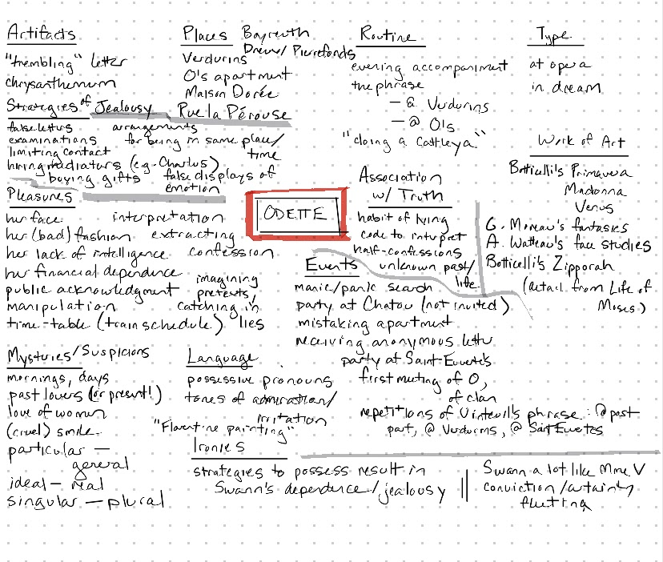
Marcel Proust, Swann in Love (1913)

Slide 61
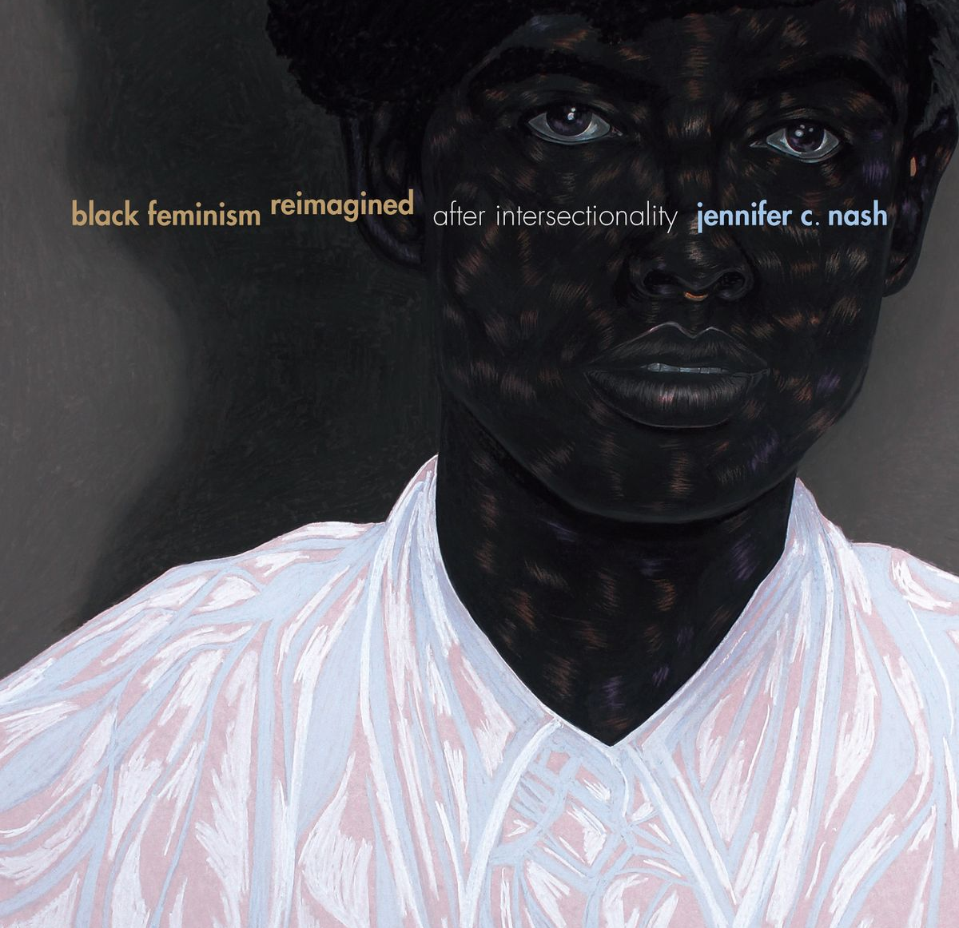
Jennifer C. Nash

Slide 62
Jennifer C. Nash, Black Feminism Reimagined
If vulnerability is a recognition that we are undone by each other, and an invitation to embrace rather than retreat from that fact, it is also a testament to how we are witnesses to moments when we are subjected to violence, particularly by social structures that have been constructed to discipline and surveil. . . [B]lack feminism has positioned and imagined black women as ‘outsiders-within’ who have a particular vantage point on how structures of domination operate to marginalize, constrain, and injure certain bodies. Black women are, then, witnesses who can see and even name forms of violence that other subjects cannot see, or simply refuse to see. (119)

Slide 63
Audre Lorde, “Uses of the Erotic: The Erotic as Power”
When I speak of the erotic, then, I speak of it as an assertion of the life-force of women; of that creative energy empowered, the knowledge and use of which we are now reclaiming in our language, our history, our dancing, our loving, our work, our lives. (32)

Slide 64
Lucille Clifton, “daughters” (1993)
daughters
woman who shines at the head
of my grandmother's bed,
brilliant woman, i like to think
you whispered into her ear
instructions. i like to think
you are the oddness in us,
you are the arrow
that pierced our plain skin
and made us fancy women;
my wild witch gran, my magic mama,
and even these gaudy girls.
i like to think you gave us
extraordinary power and to
protect us, you became the name
we were cautioned to forget.
it is enough,
you must have murmured,
to remember that i was
and that you are. woman, i am
lucille, which stands for light,
daughter of thelma, daughter
of georgia, daughter of
dazzling you. (13)

Slide 65
Works Cited
Carson, Anne. Eros the Bittersweet. Dalkey Archive, 1998. Originally published by Princeton UP, 1986.
Clifton, Lucille. The Book of Light. Copper Canyon P, 1993.
Cottom, Tressie McMillan. “You Have to Sleep Around Before You Marry an Argument.” Essaying, 8 March 2021. Substack, https://tressie.substack.com/p/sleep-around-before-you-marry-an.
Crawley, Ashon T. The Lonely Letters. Duke UP, 2020.
Derrida, Jacques. The Politics of Friendship. Translated by George Collins, Verso, 1997 [1994].
Fink, Bruce. Lacan on Love. Polity, 2016.
Firestone, Shulamith. “from The Dialectics of Sex.” Solomon and Higgins, pp. 247–56.
Freud, Sigmund. The Penguin Freud Reader. Edited with introduction by Adam Phillips, Penguin, 2006.
Hardt, Michael and Antonio Negri. Commonwealth. Harvard UP, 2009.
Hardt, Michael and Antonio Negri. Empire. Harvard UP, 2000.
Irigaray, Luce. I Love to You: Sketch of a Possible Felicity in History. Translated by Alison Martin, Routledge, 1996.
Jenkins, Carrie. What Is Love? Basic Books, 2017.
Kuzner, James. The Form of Love: Poetry’s Quarrel with Philosophy. Fordham UP, 2021.
Lawrence, D.H. The Rainbow. Edited by Mark Kinkead-Weekes, Cambridge UP, 1989 [1915].
Lorde, Audre. The Selected Works of Audre Lorde. Edited with an introduction by Roxane Gay, W.W. Norton, 2020.
Nash, Jennifer C. Black Feminism Reimagined: After Intersectionality. Duke UP, 2019.
New American Standard Bible. Lockman Foundation, 1977.
Nussbaum, Martha. Love’s Knowledge: Essays on Philosophy and Literature. Oxford UP, 1990.
Proust, Marcel. In Search of Lost Time. 6 vols. Translated by C.K. Scott Moncrieff and Terence Kilmartin, revised by D.J. Enright, introduction by Richard Howard, Modern Library, 2003 [1913–27].
Sanchez, Melissa. Queer Faith: Reading Promiscuity and Race in the Secular Love Tradition. NYU P, 2019.
Sedgwick, Eve Kosofsky. Tendencies. Duke UP, 1993.
Shakespeare, William. Shakespeare’s Sonnets. Edited with commentary by Stephen Booth, Yale UP, 1977.
Singer, Irving. “from The Nature of Love.” Solomon and Higgins, pp. 259–78.
Solomon, Robert. Love: Emotion, Myth, and Metaphor. Prometheus Books, 1990 [1981].
Solomon, Robert and Kathleen M. Higgins, editors. The Philosophy of Erotic Love. Foreword by Arthur C. Danto, U of Kansas P, 1991.
Spillers, Hortense. Black, White, and in Color: Essays in American Literature and Culture. U of Chicago P, 2003.
Spivak, Gayatri Chakravorty. An Aesthetic Education in the Era of Globalization. Harvard UP, 2012.
Teridman, Richard. “Can We Read the Book of Love?” PMLA, vol. 126, no. 2, 2011, pp. 472–82.
Walcott, Derek. Collected Poems: 1948–84. Faber and Faber, 1986.

Slide 66
Finding Love in Literary Studies
Benjamin D. Hagen, Ph.D.
Fall 2021 Colloquium Series

